Slide 1
Warm-up Activity
Human sorting
Sort these numbers in ascending order:
6
Notes:
Let’s start with a game: sorting numbers! Do this without writing things down. You have 5 seconds.
Human sorting activity: show numbers of items and list of items
(5min)

Slide 2
Warm-up Activity
Human sorting
Sort these numbers in ascending order:
6
6
Notes:
Human sorting activity: show numbers of items and list of items

Slide 3
Warm-up Activity
Human sorting
Sort these numbers in ascending order:
5, 4, 12, 1, 20, 18, 3, 9, 36, 24
Notes:
Now sort this. You have 30 seconds.

Slide 4
Warm-up Activity
Human sorting
Sort these numbers in ascending order:
5, 4, 12, 1, 20, 18, 3, 9, 36, 24
1, 3, 4, 5, 9, 12, 18, 20, 24, 36
Notes:
To answer this question, let's think about why we use computers instead of people to solve problems.
Human sorting activity: show numbers of items and list of items

Slide 5
Warm-up Activity
Human sorting
Sort these numbers in ascending order:
9, 526, 15, 259, 533, 535, 24, 537, 541, 547, 548, 552, 43, 556, 48, 51, 571, 572, 579, 69, 582, 72, 76, 80, 86, 609, 611, 111, 140, 633, 396, 636, 638, 641, 652, 660, 25, 153, 154, 155, 669, 674, 171, 178, 180, 696, 187, 707, 713, 714, 719, 226, 744, 745, 241, 759, 768, 258, 771, 781, 270, 793, 794, 798, 801, 813, 304, 817, 307, 315, 835, 841, 330, 851, 854, 346, 863, 353, 869, 358, 871, 876, 881, 373, 375, 908, 918, 418, 941, 157, 946, 435, 439, 455, 975, 465, 468, 984, 487, 496
Notes:
Now sort this. You have 30 seconds.

Slide 6
Warm-up Activity
Human sorting
Sort these numbers in ascending order:
9, 526, 15, 259, 533, 535, 24, 537, 541, 547, 548, 552, 43, 556, 48, 51, 571, 572, 579, 69, 582, 72, 76, 80, 86, 609, 611, 111, 140, 633, 396, 636, 638, 641, 652, 660, 25, 153, 154, 155, 669, 674, 171, 178, 180, 696, 187, 707, 713, 714, 719, 226, 744, 745, 241, 759, 768, 258, 771, 781, 270, 793, 794, 798, 801, 813, 304, 817, 307, 315, 835, 841, 330, 851, 854, 346, 863, 353, 869, 358, 871, 876, 881, 373, 375, 908, 918, 418, 941, 157, 946, 435, 439, 455, 975, 465, 468, 984, 487, 496
9, 15, 24, 25, 43, 48, 51, 69, 72, 76, 80, 86, 111, 140, 153, 154, 155, 157, 171, 178, 180, 187, 226, 241, 258, 259, 270, 304, 307, 315, 330, 346, 353, 358, 373, 375, 396, 418, 435, 439, 455, 465, 468, 487, 496, 526, 533, 535, 537, 541, 547, 548, 552, 556, 571, 572, 579, 582, 609, 611, 633, 636, 638, 641, 652, 660, 669, 674, 696, 707, 713, 714, 719, 744, 745, 759, 768, 771, 781, 793, 794, 798, 801, 813, 817, 835, 841, 851, 854, 863, 869, 871, 876, 881, 908, 918, 941, 946, 975, 984
Notes:
Clearly everyone got the answer below right?

Slide 7
Warm-up Activity
Human sorting
Why did it get harder to sort the numbers?

Slide 8
CST 370 – ADVANCED ALGORITHMS
5.1 Big-O Analysis for Time & Space Complexity
Notes:
Today we’re going to talk about time complexity

Slide 9
Objectives
You will be able to…
Informally define time, space, and computational complexity.
Informally define Big O notation. Understand how to count operations to approximate Big O.
Identify the formal definition of Big O notation.
Identify common computational complexities and order them by
efficiency.

Slide 10
What makes an algorithm good?
Notes:
First, let’s talk about algorithms. What makes an algorithm good?
Correctness
Generality
Efficiency

Slide 11
What makes an algorithm good?
1:
Correctness
Does following the algorithm produce the right answer?

Slide 12
What makes an algorithm good?
1:
Correctness
Does following the algorithm produce the right answer?
2:
Generality
Does the algorithm work for all possible inputs?

Slide 13
What makes an algorithm good?
1:
Correctness
Does following the algorithm produce the right answer?
2:
Generality
Does the algorithm work for all possible inputs?
3:
Efficiency
How quickly does the algorithm produce the answer?

Slide 14
Computational Complexity
Why Efficiency Matters
Why use a computer instead of a person to solve a problem?
Speed. An algorithm that is correct and general but too slow (inefficient) is impractical.
Notes:
Why do we care about efficiency? Because an inefficient algorithm is useless. Algorithms should be fast. If the perfect algorithm is too slow, it’s impractical.
Human sorting activity: show numbers of items and list of items

Slide 15
Computational Complexity
Size Matters Too
Why use a computer instead of a person to solve a problem?
Speed. An algorithm that is correct and general but too slow (inefficient) is impractical.
Size. An algorithm that slows down too much on large inputs is also useless.
Notes:
To answer this question, let's think about why we use computers instead of people to solve problems.
Human sorting activity: show numbers of items and list of items

Slide 16
Computational Complexity
Definition
Computational complexity refers to how efficient the algorithm is as it scales.
Notes:
To answer this question, let's think about why we use computers instead of people to solve problems.
Human sorting activity: show numbers of items and list of items

Slide 17
Computational Complexity
Definition
Computational complexity refers to how efficient the algorithm is as it scales to larger and larger inputs.
Notes:
To answer this question, let's think about why we use computers instead of people to solve problems.
Human sorting activity: show numbers of items and list of items

Slide 18
Computational Complexity
Definition
Computational complexity refers to how efficient the algorithm is as it scales to larger and larger inputs.
Efficiency is not just about time. In what other way do we need our algorithms to be efficient?
Notes:
To answer this question, let's think about why we use computers instead of people to solve problems.
Human sorting activity: show numbers of items and list of items

Slide 19
Computational Complexity
Definition
Computational complexity refers to how efficient the algorithm is as it scales to larger and larger inputs.
Efficiency is not just about time. In what other way do we need our algorithms to be efficient?
Space. A lightening-fast algorithm is useless if it requires more memory than exists on my computer!
Notes:
To answer this question, let's think about why we use computers instead of people to solve problems.
Human sorting activity: show numbers of items and list of items

Slide 20
Computational Complexity
Definition
Computational complexity refers to how efficient the algorithm is as it scales to larger and larger inputs.
Time complexity refers to how the number of operations it takes to run the algorithm is related to its input size.
Space complexity refers to how the amount of additional memory an algorithm consumes is related to its input size.
Notes:
To answer this question, let's think about why we use computers instead of people to solve problems.
Human sorting activity: show numbers of items and list of items

Slide 21
Computational Complexity
Measurement
How do we measure computational complexity?
Notes:
To answer this question, let's think about why we use computers instead of people to solve problems.
Human sorting activity: show numbers of items and list of items

Slide 22
Computational Complexity
Measurement
How do we measure computational complexity?
With Big-O notation!
Notes:
To answer this question, let's think about why we use computers instead of people to solve problems.
Human sorting activity: show numbers of items and list of items

Slide 23
Big O Notation
Informal Definition
O(n): Read this as “Big O of n.” Assume n represents a mathematical expression.
Notes:
To answer this question, let's think about why we use computers instead of people to solve problems.
Human sorting activity: show numbers of items and list of items

Slide 24
Big O Notation
Informal Definition
O(n): Read this as “Big O of n.” Assume n represents a mathematical expression.
We say an algorithm takes O(n)time if it takes n*c operations or fewer to run for all input sizes n >= k, where c and k are constants.
Notes:
To answer this question, let's think about why we use computers instead of people to solve problems.
Human sorting activity: show numbers of items and list of items

Slide 25
Big O Notation
Informal Definition
O(n): Read this as “Big O of n.” Assume n represents a mathematical expression.
We say an algorithm takes O(n)space if it consumes n*c units of memory or fewer for all input sizes n >= k, where c and k are constants.
Notes:
To answer this question, let's think about why we use computers instead of people to solve problems.
Human sorting activity: show numbers of items and list of items

Slide 26
Big O Notation
Informal Definition
O(n): Read this as “Big O of n.” Assume n represents a mathematical expression.
If this is confusing, think of O(n) time as meaning an algorithm takes approximately n operations at most to run.
Notes:
To answer this question, let's think about why we use computers instead of people to solve problems.
Human sorting activity: show numbers of items and list of items

Slide 27
Big O Notation
Informal Definition
O(n): Read this as “Big O of n.” Assume n represents a mathematical expression.
If this is confusing, think of O(n) time as meaning an algorithm takes approximately n operations at most to run.
Similarly, think of O(n) space as meaning an algorithm consumes approximately n units of memory at most to run.
Notes:
To answer this question, let's think about why we use computers instead of people to solve problems.
Human sorting activity: show numbers of items and list of items

Slide 28
Big O Notation
Informal Definition
O(n): Read this as “Big O of n.” Assume n represents a mathematical expression.
Big O is an approximation that tells us about an algorithm’s worst-case scenario use of time or space.
Notes:
To answer this question, let's think about why we use computers instead of people to solve problems.
Human sorting activity: show numbers of items and list of items

Slide 29
Big O Notation
Informal Definition
What if we just say an algorithm is O(n)?
Notes:
To answer this question, let's think about why we use computers instead of people to solve problems.
Human sorting activity: show numbers of items and list of items

Slide 30
Big O Notation
Informal Definition
What if we just say an algorithm is O(n)?
If we do not specify time or space, you can safely assume we are talking about time.
Notes:
To answer this question, let's think about why we use computers instead of people to solve problems.
Human sorting activity: show numbers of items and list of items

Slide 31
Big O Notation
Informal Definition
What if we just say an algorithm is O(n)?
If we do not specify time or space, you can safely assume we are talking about time.
In practice, time is usually the more constrained resource in modern-day programming given that available memory has grown exponentially since the invention of computers. However, we will talk about some time-space trade-offs later in the course.
Notes:
To answer this question, let's think about why we use computers instead of people to solve problems.
Human sorting activity: show numbers of items and list of items

Slide 32
What’s ‘n’?
Scaling by input size
Big-O is always described in terms of input size.
To figure out the input size, look at a function’s parameters and ask What does it mean for this to be bigger?

Slide 33
What’s ‘n’?
Scaling by input size
Integers: 0, 100, 370, 108273487612349817234
Strings: “”, “ab”, “abc”, “abcdefgh…..”
Lists: [], [1], [1, 3, 5], [0, 1, 2, 3, 4, 5, 6, 7, ….]
Big O can be in terms of multiple variables if there’s more than one parameter!

Slide 34
Common Complexity Classes
O(1)
O(1) = Constant-time/space.
The number of operations / additional memory needed does not change based on input size.
Think of the swap function.

Slide 35
Common Complexity Classes
O(log n)
O(log n) = Logarithmic time/space.
The number of operations / memory needed changes at a variable but significant rate.
Typically shows up when you only look at a small number of elements in the input.

Slide 36
Common Complexity Classes
O(n)
O(n) = Linear-time/space.
The number of operations / memory needed does changes at a constant rate based on input size.
Typically shows up when you iterate through the input.

Slide 37
Common Complexity Classes
O(nlogn)
O(nlogn) = Linear Logarithmic-time.
A combination of two classes. O(nlogn) typically means you’re doing something that takes O(logn) time/space O(n) times. (Or the opposite).

Slide 38
Common Complexity Classes
O(n^2)
O(n^2) = Quadratic-time.
A combination of two classes. O(n^2) is a part of a larger class: O(n^c) or polynomial time.
Think of it as O(n*n) or, doing something that takes O(n) time/space O(n) times.

Slide 39
Common Complexity Classes
O(2^n)
O(2^n) = Exponential-time.
A complexity class that grows very quickly. Typically seen in brute force algorithms where you try all possible combinations of inputs. (order doesn’t matter).

Slide 40
Common Complexity Classes
O(n!)
O(n!) = Factorial-time.
A complexity class that grows even faster than exponential time. Typically seen in brute force algorithms where you try all possible permutations of inputs. (order does matter).

Slide 41
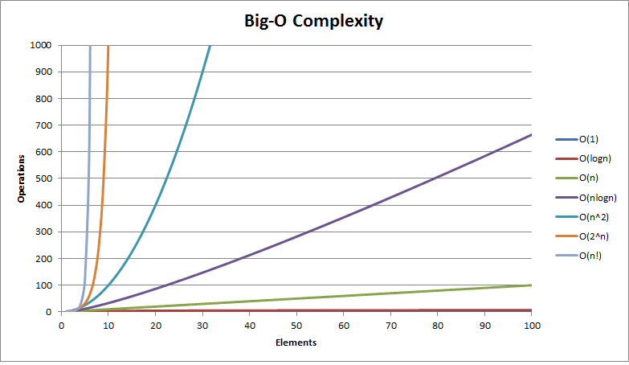
Common Complexity Classes
A graph of input size to operations

Slide 42
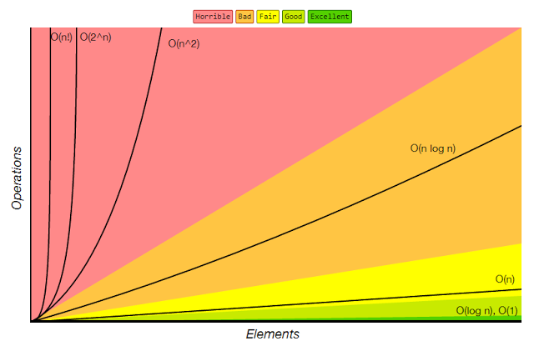
Common Complexity Classes
Complexity classes compared
http://bigocheatsheet.com/

Slide 43
Big O Notation
Formal Definition
Mathematically, Big-O is a (loose) upper bound on the number of operations or amount of memory used by an algorithm.
Notes:
To answer this question, let's think about why we use computers instead of people to solve problems.
Human sorting activity: show numbers of items and list of items

Slide 44
Big O Notation
Formal Definition
Mathematically, Big-O is a (loose) upper bound on the number of operations or amount of memory used by an algorithm.
An algorithm f(n) is O(g(n)) if there exist positive constants c and k such that 0 <= f(n) <= c*g(n) for all n >= k.
Notes:
To answer this question, let's think about why we use computers instead of people to solve problems.
Human sorting activity: show numbers of items and list of items

Slide 45
Big O Notation
Do Now
What does it mean for an algorithm to be O(n²)?
Hint: Think about what O(n) means and generalize it.

Slide 46
Big O Notation
Do Now
What does it mean for an algorithm to be O(n²)?
Hint: Think about what O(n) means and generalize it.
An algorithm is O(n²) if it takes n²*c operations or fewer to run for all input sizes n >= k, where c and k are constants.

Slide 47
Big O Notation
Do Now
What does it mean for an algorithm to be O(n²)?
Hint: Think about what O(n) means and generalize it.
An algorithm is O(n²) if it takes n²*c operations or fewer to run for all input sizes n >= k, where c and k are constants.
But wait! If it takes n*c operations or fewer to run an algorithm, then it it also takes n²*c operations or fewer since n <= n²*c (for all possible input sizes; i.e., positive integers).

Slide 48
Big O Notation
Do Now
What does it mean for an algorithm to be O(n²)?
Hint: Think about what O(n) means and generalize it.
An algorithm is O(n²) if it takes n²*c operations or fewer to run for all input sizes n >= k, where c and k are constants.
But wait! If it takes n*c operations or fewer to run an algorithm, then it it also takes n²*c operations or fewer since n <= n²*c (for all possible input sizes; i.e., positive integers).
Always give the smallest (most efficient) correct complexity for Big O.

Slide 49
Big O Notation
Formal Definition
Mathematically, Big-O is the least (loose) upper bound on the number of operations or amount of memory used by an algorithm.
Notes:
To answer this question, let's think about why we use computers instead of people to solve problems.
Human sorting activity: show numbers of items and list of items

Slide 50
Big O Notation
Still Confused?
All of these are good ways to think about Big O:
Notes:
To answer this question, let's think about why we use computers instead of people to solve problems.
Human sorting activity: show numbers of items and list of items

Slide 51
Big O Notation
Still Confused?
All of these are good ways to think about Big O:
The growth rate of an algorithm
The efficiency of an algorithm
The effect of the input on the speed or memory consumption of an algorithm
Notes:
To answer this question, let's think about why we use computers instead of people to solve problems.
Human sorting activity: show numbers of items and list of items

Slide 52
Intermission
10-minute break
EIR surveys.
https://www.surveymonkey.com/r/F86XV69
https://www.surveymonkey.com/r/G9XKGK8
Pick up a worksheet when you’re done.

Slide 53
CST 370 – ADVANCED ALGORITHMS
5.2 Counting operations to approximate Big-O

Slide 54
Objectives
You will be able to…
Determine informally the time and space complexity of simple algorithms
Count operations to calculate the Big O of iterative algorithms.
Identify and justify the time and space complexities of bubble sort, selection sort, and binary search by counting operations.
Notes:
So this second mini-lesson will be more of a lab-style. We’re going to practice identifying the time and space complexities of simple algorithms by a method where we count operators.

Slide 55
Computational Complexity
Definition
Computational complexity refers to how efficient the algorithm is as it scales to larger and larger inputs.
Time complexity refers to how the number of operations it takes to run the algorithm is related to its input size.
Space complexity refers to how the amount of additional memory an algorithm consumes is related to its input size.
Notes:
First let’s review time and space complexity.

Slide 56
Big O Notation
Informal Definition
O(n): Read this as “Big O of n.” Assume n represents a mathematical expression.
If this is confusing, think of O(n) time as meaning an algorithm takes approximately n operations at most to run.
Similarly, think of O(n) space as meaning an algorithm consumes approximately n units of memory at most to run.
Notes:
To answer this question, let's think about why we use computers instead of people to solve problems.
Human sorting activity: show numbers of items and list of items

Slide 57
Big O Notation
Informal Definition
O(n): Read this as “Big O of n.” Assume n represents a mathematical expression.
If this is confusing, think of O(n) time as meaning an algorithm takes approximately n operations at most to run.
Similarly, think of O(n) space as meaning an algorithm consumes approximately n units of memory at most to run.
Notes:
To answer this question, let's think about why we use computers instead of people to solve problems.
Human sorting activity: show numbers of items and list of items

Slide 58
What’s ‘n’?
Scaling by input size
Integers: 0, 100, 370, 108273487612349817234
Strings: “”, “ab”, “abc”, “abcdefgh…..”
Lists: [], [1], [1, 3, 5], [0, 1, 2, 3, 4, 5, 6, 7, ….]
Big O can be in terms of multiple variables if there’s more than one parameter!

Slide 59
Calculating Big O: Counting Operators
Algorithm
Independently evaluate each line, counting how many times it runs relative the input size.
Combine nested loop complexities:
Sum complexities in innermost loop body.
Drop all constants and lesser terms from the sum.
Multiply the complexities of the loop and the loop body.
Drop all constants and lesser terms from the product.
Repeat steps a-d for the next loop (if applicable) working your way out.
Add complexities for all top-level operations.
Drop all constants and lesser terms from the sum.

Slide 60
Calculating Big O
Counting Operators: Time
void someFunc(int a, int b) {
int a = b * b;
int b = a * a;
return a * b;
}
Notes:
O(1) time

Slide 61
Calculating Big O
Counting Operators: Time
void someFunc(int n) {
int z = 9;
int y = 9;
for(int i = 0; i < n; i++) {
z--;
y++;
}
cout << z*y << endl;
}
Notes:
O(n) time

Slide 62
Calculating Big O
Counting Operators: Time
vector<int> someFunc(int n) {
int sum = 0;
auto res = vector<int>();
for (int i = 0; i < n; i++) {
for (int j = 1; j <= n; j *= 2) {
int prod = i * j;
sum += prod;
res.push_back(sum);
}
}
return res;
}
Notes:
O(nLogn) time

Slide 63
Calculating Big O: Counting Operators
Algorithm
Independently evaluate each line, counting how many times it runs relative the input size.
Combine nested loop complexities:
Sum complexities in innermost loop body.
Drop all constants and lesser terms from the sum.
Multiply the complexities of the loop and the loop body.
Drop all constants and lesser terms from the product.
Repeat steps a-d for the next loop (if applicable) working your way out.
Add complexities for all top-level operations.
Drop all constants and lesser terms from the sum.

Slide 64
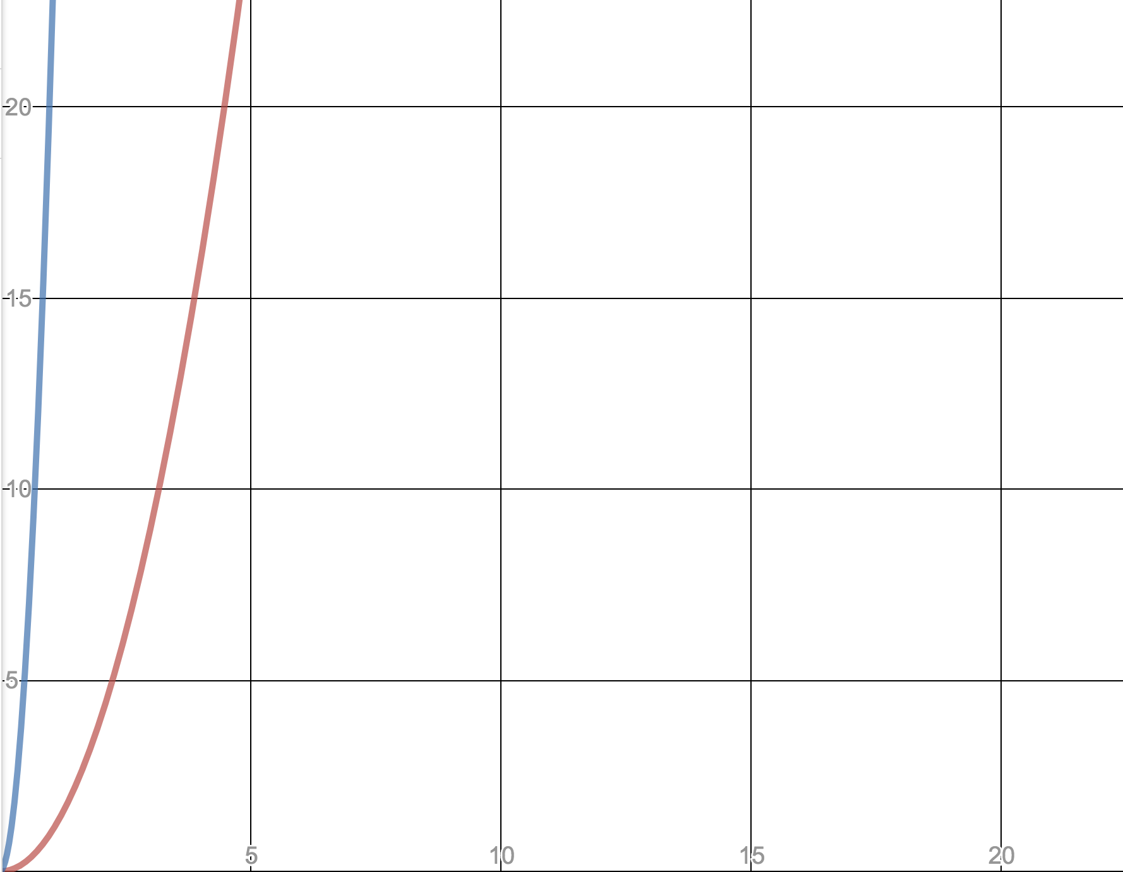
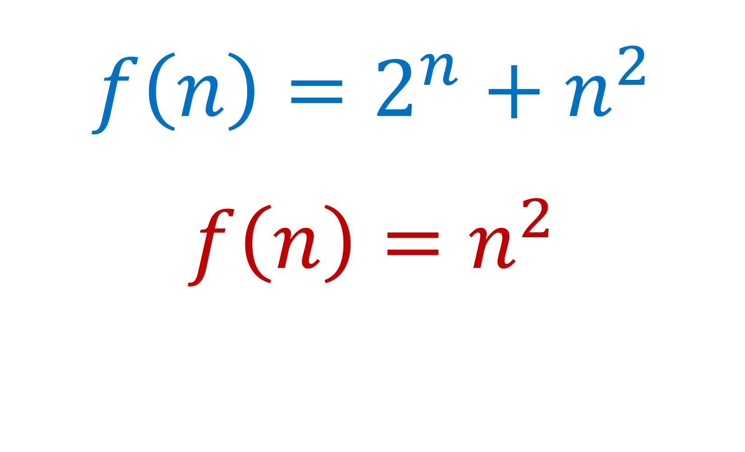
Calculating Big O: Counting Operators
Why drop the lesser terms?

Slide 65
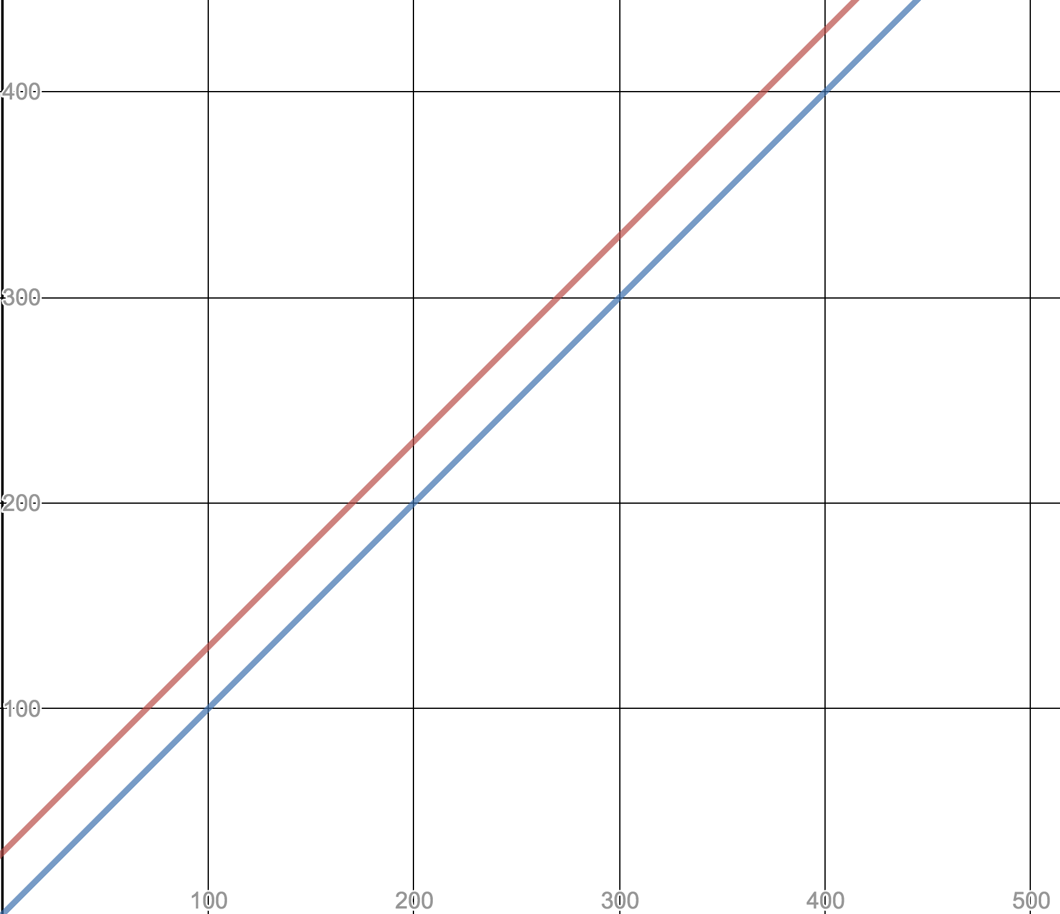
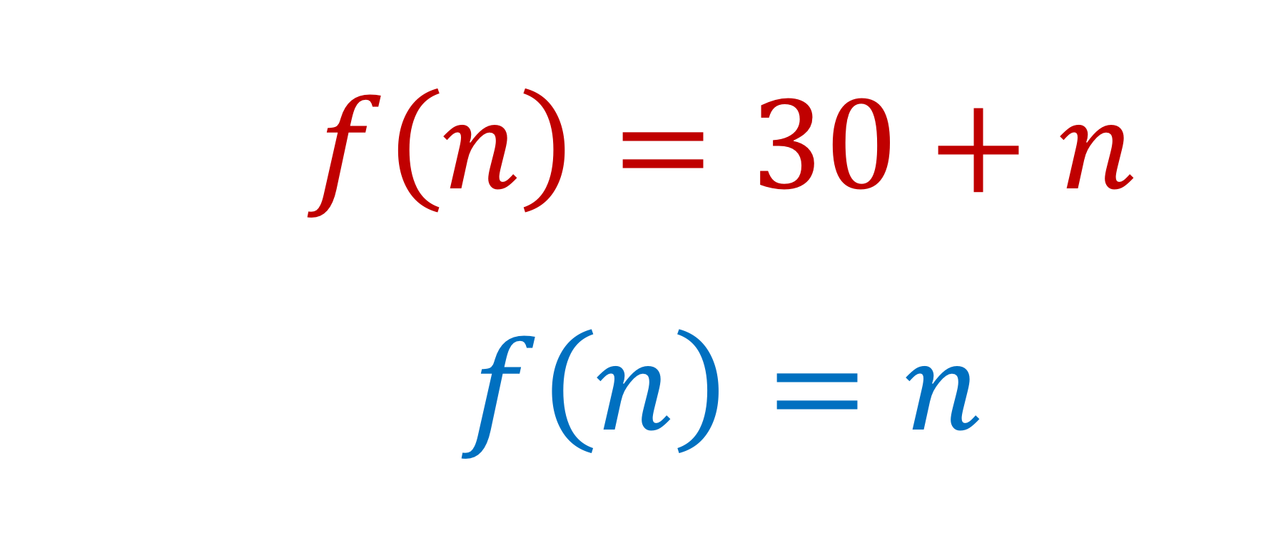
Calculating Big O: Counting Operators
Why drop the constants?

Slide 66
Calculating Big O
Counting Operators: Space
void someFunc(int n) {
int z = 9;
int y = 9;
for(int i = 0; i < n; i++) {
z--;
y++;
}
cout << z*y << endl;
}
Notes:
O(n) time

Slide 67
Calculating Big O
Counting Operators: Space
vector<int> someFunc(int n) {
int sum = 0;
auto res = vector<int>();
for (int i = 0; i < n; i++) {
for (int j = 1; j <= n; j *= 2) {
int prod = i * j;
sum += prod;
res.push_back(sum);
}
}
return res;
}
Notes:
O(nLogn) time

Slide 68
Calculating Big O
Counting Operators: Space
vector<int> someFunc(int n) {
int sum = 0;
auto res = vector<int>();
for (int i = 0; i < n; i++) {
for (int j = 1; j <= n; j *= 2) {
int prod = i * j;
sum += prod;
res.push_back(sum);
}
}
return res;
}
Notes:
O(nLogn) time

Slide 69
Calculating Big O
A real algorithm: time
void bubbleSort(vector<int>& list) {
for (int sc = 0; sc < list.size() - 1; sc++) {
for (int i = 0;i < list.size() - sc - 1; i++) {
if(list[i] > list[i+1]) {
int temp = list[i];
list[i] = list[i+1];
list[i+1] = temp;
}
}
}
}
Notes:
O(nLogn) time

Slide 70
Calculating Big O
A real algorithm: space
void bubbleSort(vector<int>& list) {
for (int sc = 0; sc < list.size() - 1; sc++) {
for (int i = 0;i < list.size() - sc - 1; i++) {
if(list[i] > list[i+1]) {
int temp = list[i];
list[i] = list[i+1];
list[i+1] = temp;
}
}
}
}
Notes:
O(nLogn) time

Slide 71
Now it’s your turn!
Determine the Big O on your own
Work together to analyze the rest of the algorithms on the worksheet.
Separate the last page and turn that in for in-class work credit.

Slide 72
Calculating Big O: Counting Operators
Algorithm
Independently evaluate each line, counting how many times it runs relative the input size.
Combine nested loop complexities:
Sum complexities in innermost loop body.
Drop all constants and lesser terms from the sum.
Multiply the complexities of the loop and the loop body.
Drop all constants and lesser terms from the product.
Repeat steps a-d for the next loop (if applicable) working your way out.
Add complexities for all top-level operations.
Drop all constants and lesser terms from the sum.

